Slide 1

River Valley Cycling Inc.
2021 Annual General Meeting
2 March 2021

Slide 2





Thanks to our 2020 sponsors!
Notes:
Needs to be updated by Scott and Melissa
Add:
Maritime Case
Greer’s Mtn. Salvage
Velo NB
Change:
Rad Edge
Russon
Remsoft
TIF list
Remove:
Home Hardware
Crabbe Mtn.
Picaroons

Slide 3
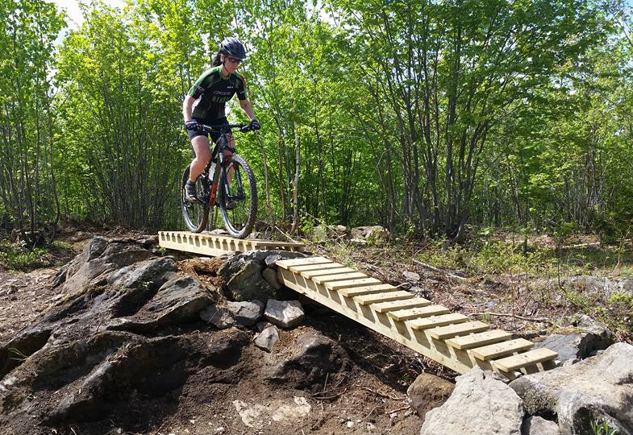
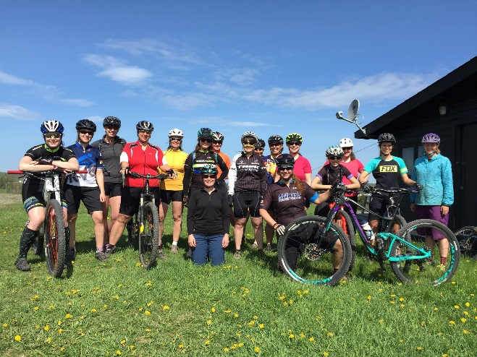
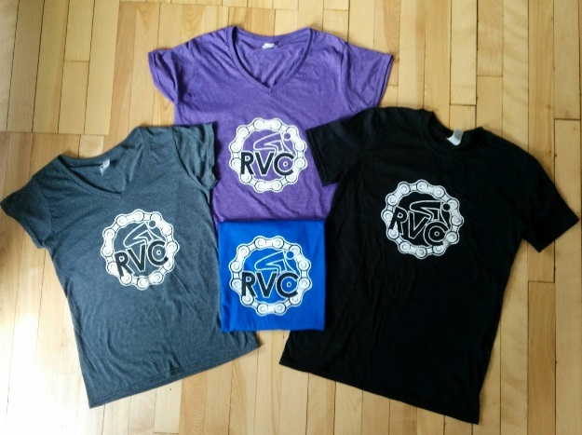
Announcements
Notes:
Topped 600 members
MVP jump park and flow trails and CBC
Trail development and signage at Woolastook

Slide 4
1. Announcements
Who we are Video
2. Approval of the Agenda
3. Approval of 2020 Minutes (previously distributed)
4. New Business
(a) Membership Report (Nick)
(b) Financial Report (Norman)
(c) Winterbike Report (Dan)
(d) Trails
(e) Priorities for 2021 (Chris N)
(f) Questions
(g) Election of Executive and Directors
5. Adjournment
Agenda

Slide 5
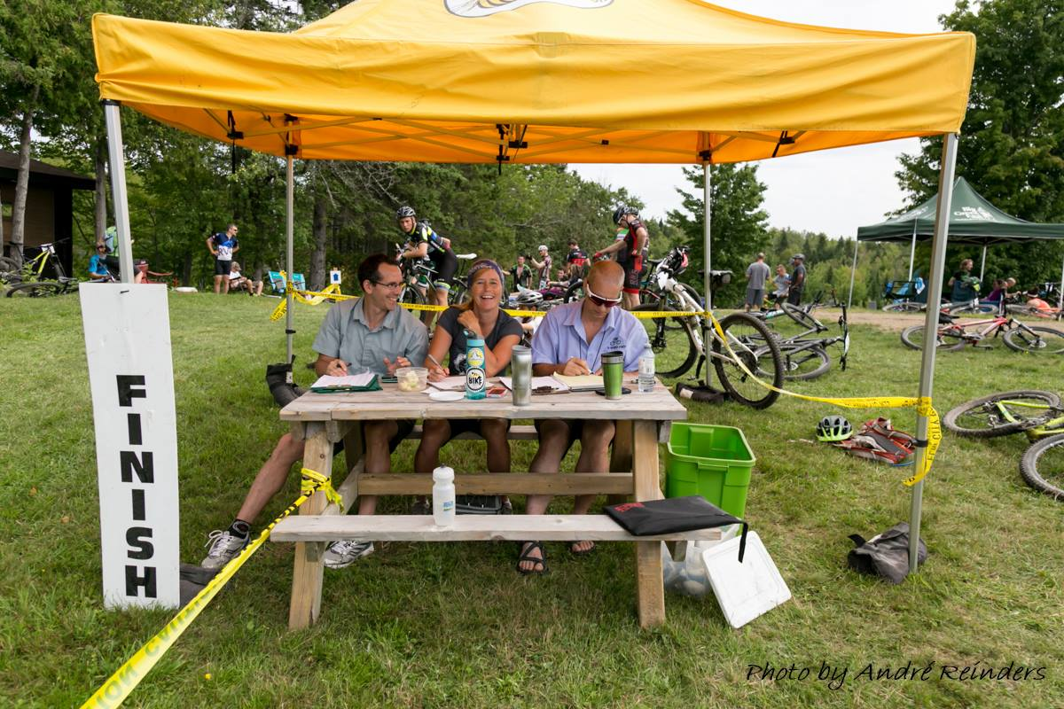
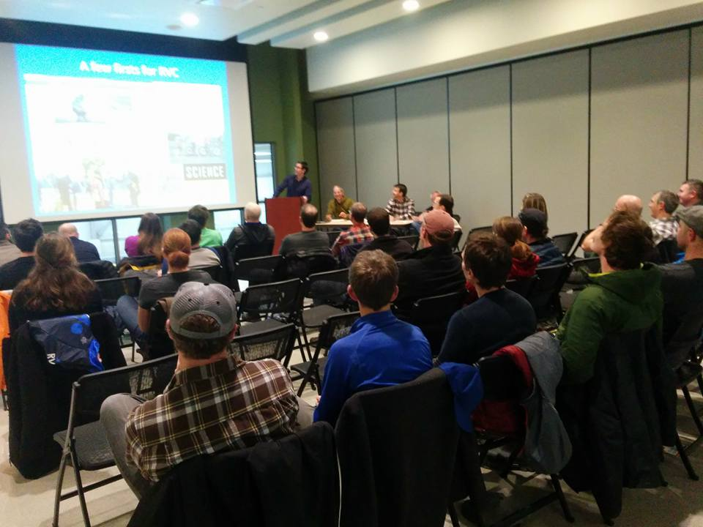
Approval of Agenda
Approval of Minutes
Notes:
Find minutes from last AGM and circulate to members (Norm/Kelly)

Slide 6
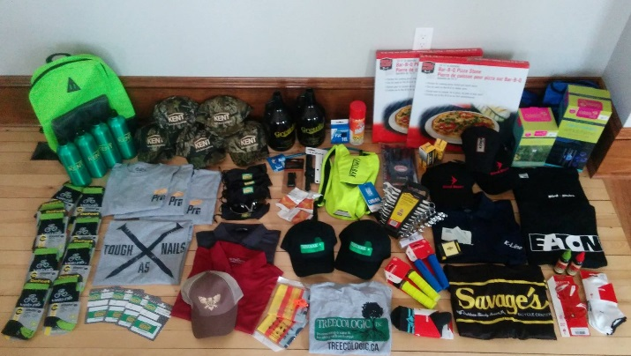
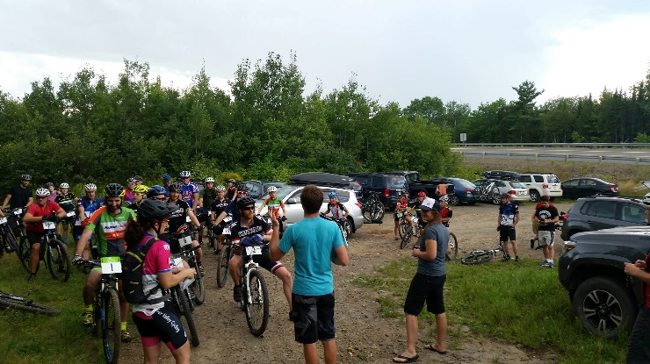
Membership and Sponsor Report

Slide 7
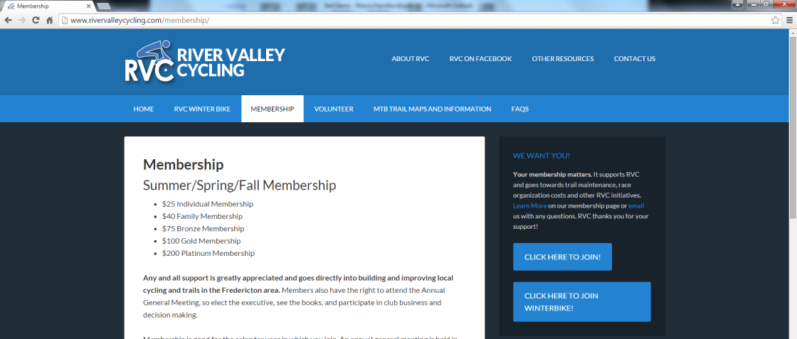

Membership
RVC Membership:
2011 = 20 members
2012 = 50 members
2013 = 106 members
2014 = 230 members
2015 = 261 members
2016 = 370 members
2017 = 335 members
2018 = 403 members
2019 = 602 members
2020 = 550 members

Slide 8
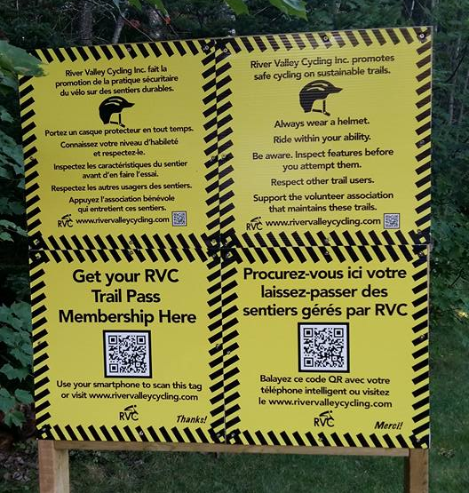
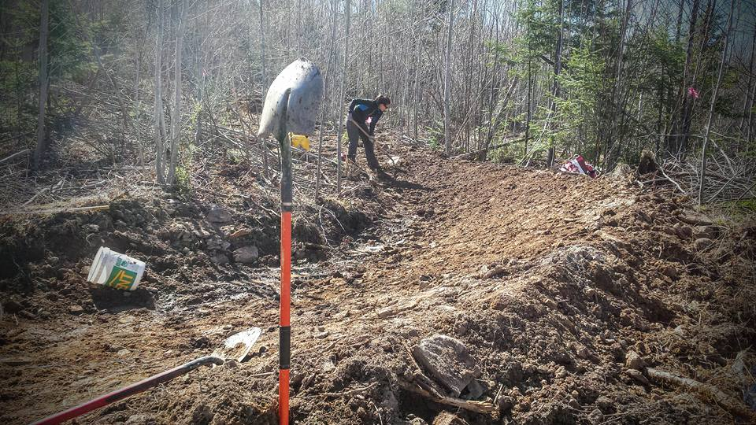
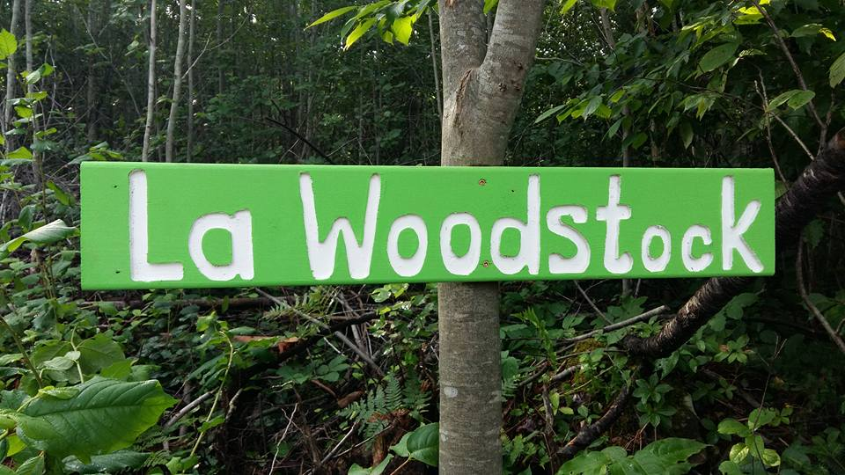
Financial Report

Slide 9
Overview
2019-20 | Total | Winterbike
Income | $21,894 | $5,449
Expenses | $25,343 | $4,602
Net | ($3,449) | $847
2020-21 | Total | Winterbike (to date)
Income | $26,654 | $6,020
Expenses | $20,776 | $4,344
Net | $5,878 | $1,676

Slide 10
Income
(Excluding Winterbike)
(excluding Winterbike)
Events
  No summer events
  Tour de Beer (Winterbike)
Sponsorship
  $5,000 from Velo NB
Membership !!
Total = $26,654

Slide 11
Expenses
(excluding Winterbike)
Admin
  Including Velo, IMBA affiliation
  “Who are we?” video
Insurance
  Club and Landowner
  Not including D&O
Total = $20,776

Slide 12
Trails
Penniac
  Offset by $5,000 Remsoft grant received 2019
Wooly
  Net of $6,600 TIF grant
Islandview signage
  Expenses through MCFT
Total = $13,353
  Pa

Slide 13


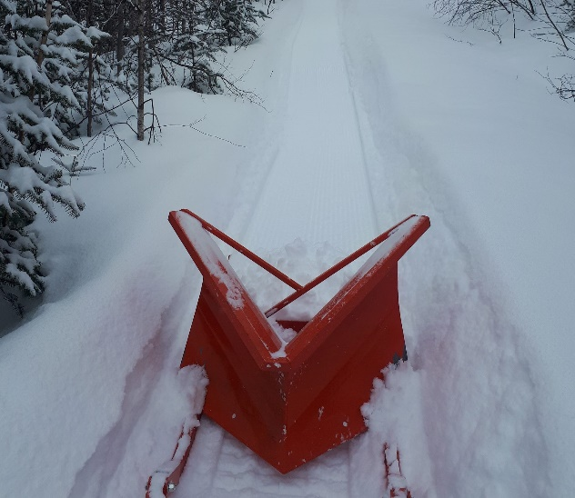
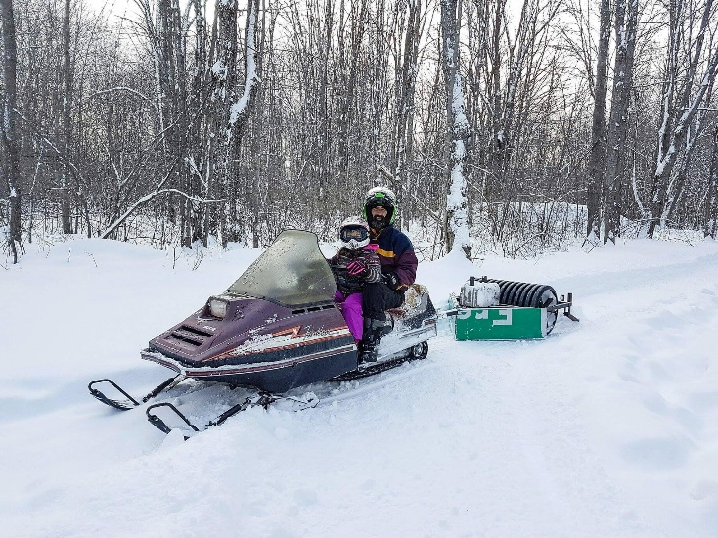
Winterbike Report
2014/15 = 26 members
2015/16 = 60 members
2016/17 = 126 members
2017/18 = 135 members
2018/19 = 161 members
2019/20 = 146 members
2020/21 = 158 members

Slide 14

Trail Network Updates
  We’re growing !!
  Penniac : Chris F
  MVP : Bev
  Mactaquac : Bev
  Woolastook : Mike

Slide 15
2021 Projects & Priorities

Slide 16

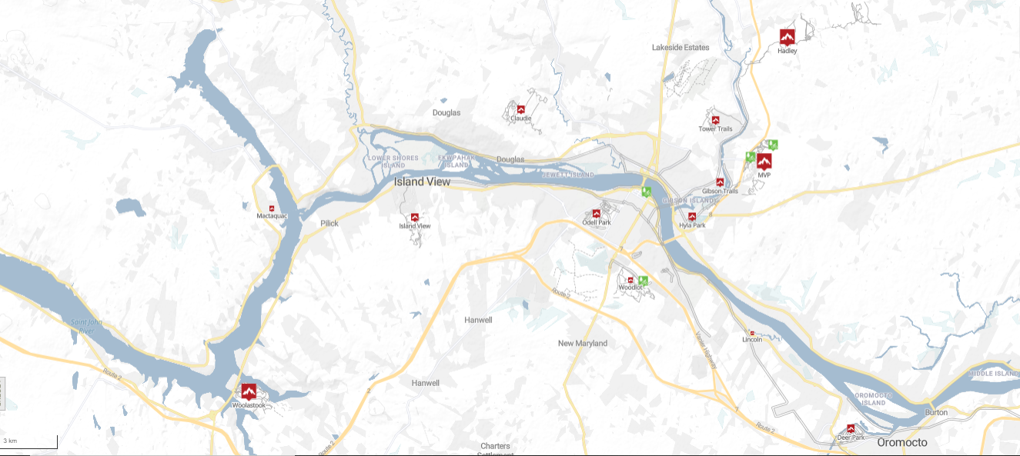


Penniac
Killarney
Brookside
Mactaquac
Islandview
Odell
Grant Harvey
Woolastook
Notes:
Continue building east from the Campground at Woolastook and open split rail. Improve the trailhead.
Establish a partnership with Mactaquac and build singletrack
Address landowner issues and reroute 2 trails at Islandview
Push city to start initiation of Odell Park plan. Review trails individually. Push for signage.
Spruce up RVC trail at Grant Harvey bike park
Brookside - new willing private landowner interested in singletrack.
Killarney Lake - work with city to determine next steps on park master plan. Budget.
Penniac - Grand opening of Uptimizer and downhill trail. Landowner relationships. Goal of opening up trails east of allen brook.

Slide 17

Elections
Notes:
Kelly stepping down from long-term volunteer as Executive Director
Nick retiring from President; putting in a succession plan for leadership
Kendall not re-offering as Director at Large
Scott’s role changing form Sponsorship to Communications Director
Melissa taking on Sponsorship Management and Fundraising
Norman retracting from Secretary/Treasurer to Treasurer
Bev re-offering as Director of Trails
Offer out to Jackie as V.P.
Offer out to Clair for Secretary
Chris accepted role of Director of Risk Management

Slide 18



